Slide 1
The app Store Analysis
Sam Kraus; Barry Tikalsy, Abbas Shivij, Farshad Esnaashari
Date: 19 OCT 2019

Slide 2
Teamwork
Work division
Data clean-up
Data frames
Graphs
Bar/Pie
Scatter
Hypothesis and Statistical Tests
Presentation

Slide 3
The process
Data options discussed
Nutrition and activity levels
Currency exchange rate trends with temperature
Violent crimes and video games
Wild-fires
App stores

Slide 4
Project Motivation
Core motivation for doing this project was to analyze the apps in Apple and Google Stores
Whose apps are higher rated?
Number of installs vs. files size
What are the top five rated categories in each app store
What are the top five rated categories for paid apps in each store
How many apps are in various price range categories

Slide 5
Data Cleanup & Exploration
Describe the exploration and cleanup process
Discuss insights you had while exploring the data that you didn't anticipate
Data frame merging
Discuss any problems that arose after exploring the data, and how you resolved them
Group by usage
Graphing techniques
Present and discuss interesting figures developed during exploration, ideally with the help of Jupyter Notebook

Slide 6
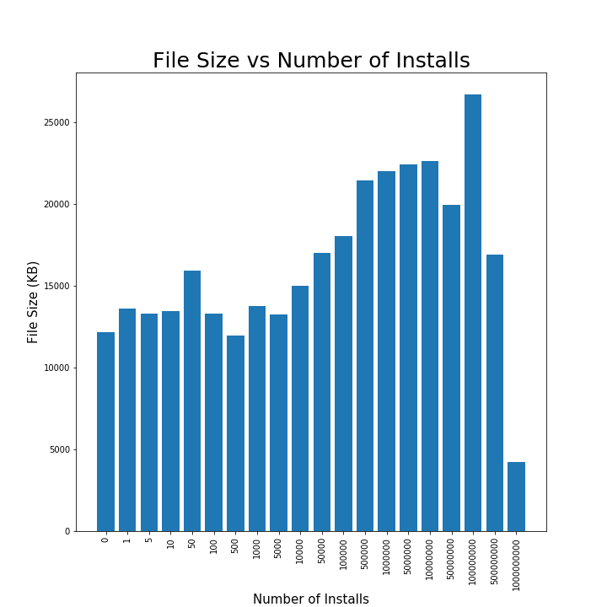
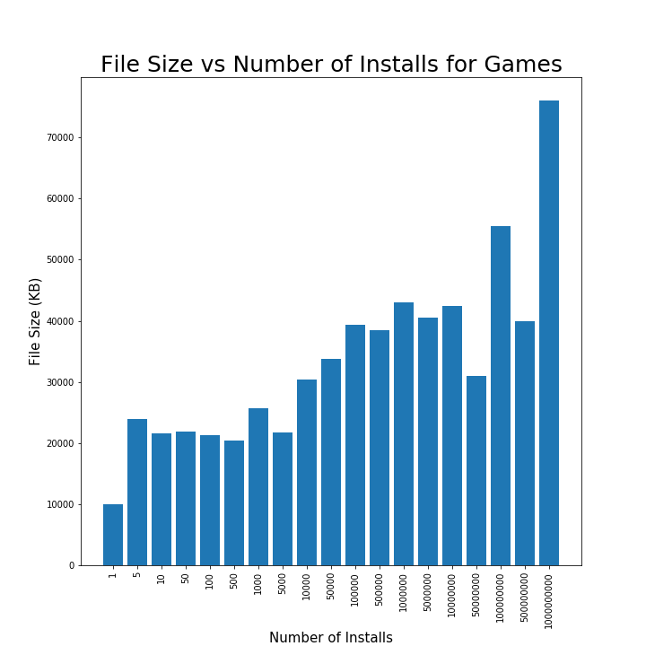
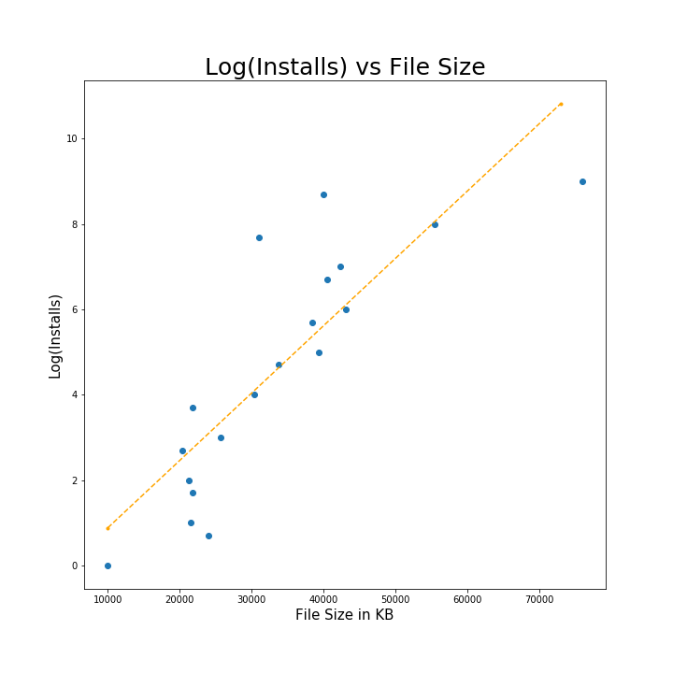
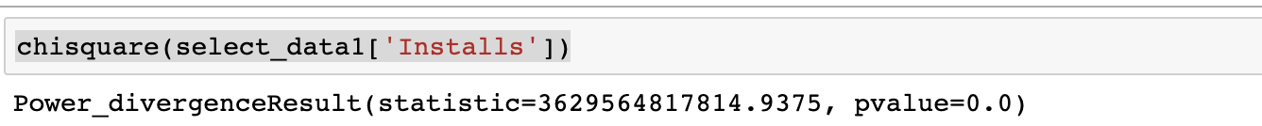

Slide 7
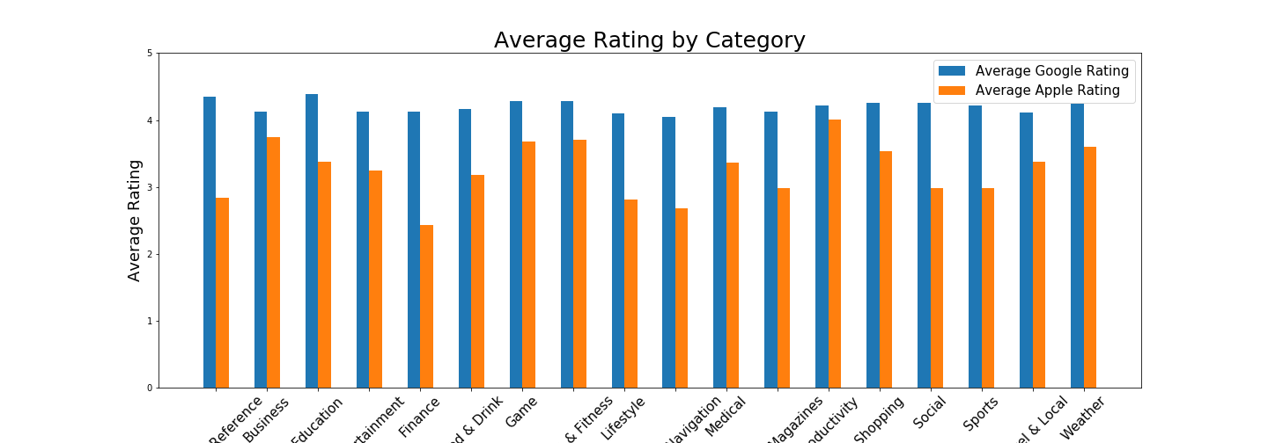
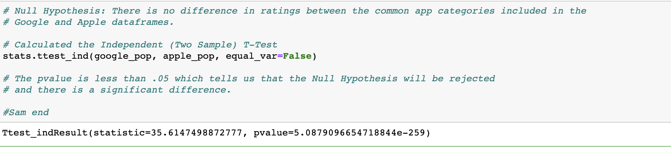

Slide 8
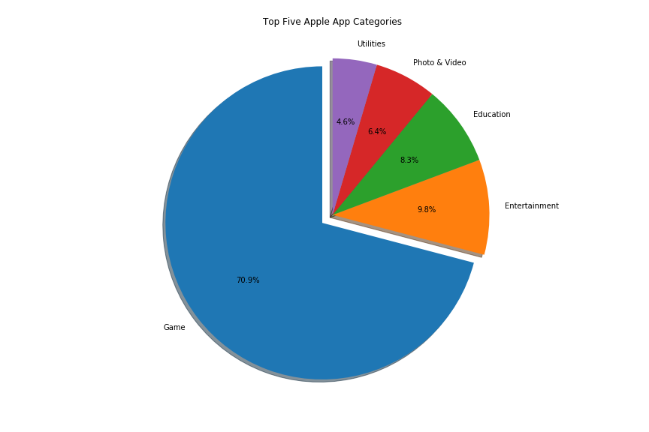
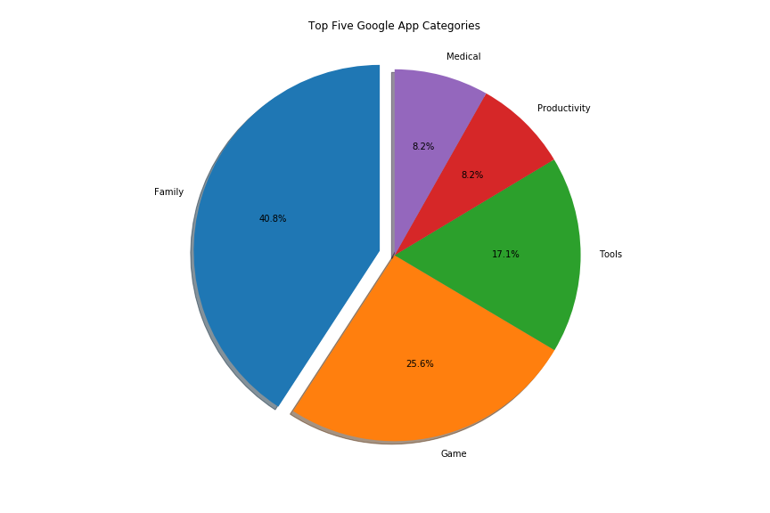
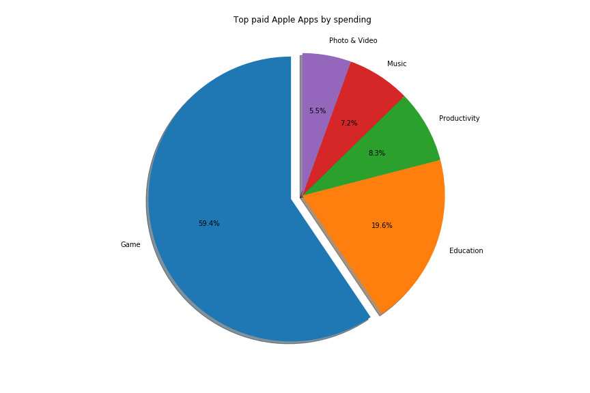
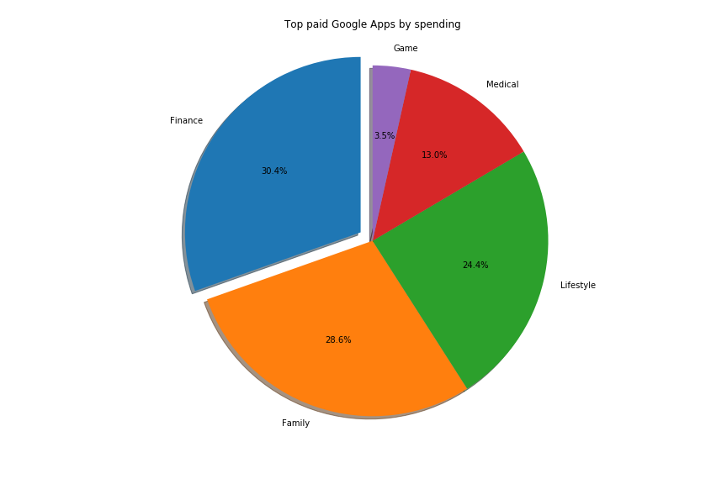

Slide 9
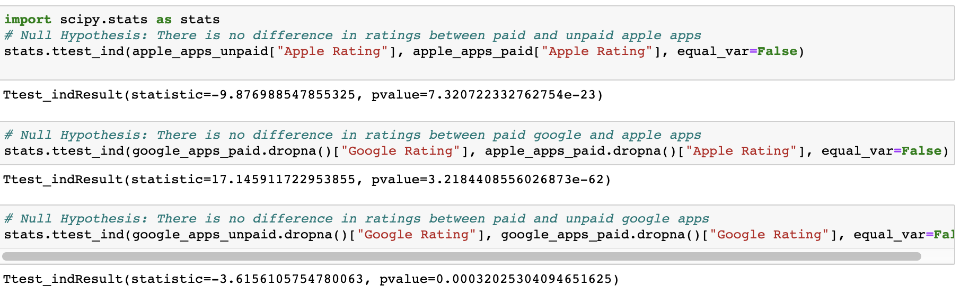

Slide 10
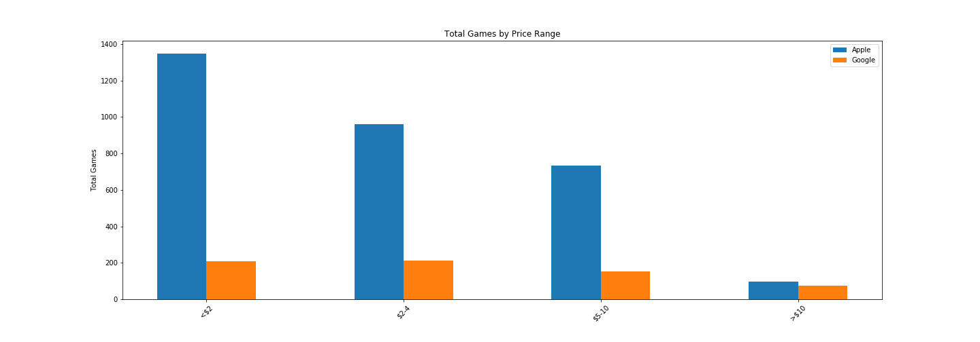
Price Ranges by Total Games

